Slide 1

Software Engineering as the Next Level Up from Programming
Oracle Groundbreakers APAC Virtual Tour 2021
Lucas Jellema, CTO & Architect AMIS | Conclusion
Notes:
TITLE
Software Engineering as the Next Level Up from Programming
DESCRIPTION
Software engineering is programming with the added dimension of time: programs that can evolve and scale, be maintained and be operated by multiple people over a longer period of time. What does it take to do software engineering in a professional manner - beyond mere programming? As programmers, our main goal is to make IT work. To translate functional specification into executable code. And sure, that is the least we can do. But we have more responsibility than this. We have to produce software that is robust and will reliably handle expected and unexpected cases. Software that is scalable and can handle expected and somewhat unexpected load gracefully. With minimal operating costs and in the greenest way possible. Software that is observable and manageable and that can be evolved with changing and new functional requirements and with changing technology. Software that will be legacy in the original, positive meaning of the word. That does not depend on the one big brain in our team or on the guy that has been around for three decades. Software that we know is good and can comfortably be modified in a controlled and productive way. We have to grow from excellent programmers to professional software engineers. This session talks about what it takes to create our code with honor. It discusses automation at every level in the build, rollout and monitoring of infrastructure (as code), platform and application, using CI/CD pipelines and DevOps procedures and tools. The session talks about testing – before and during development as well as after each change anywhere in the system and for both functional and non-functional aspects. Test driven development, regression testing and smoke testing are among the concepts discussed. The term ‘clean code’ refers to code that is readable, testable and maintainable. Through code analysis and peer reviews and by performing refactoring we constantly refine our software to be collectively adaptable. The session demonstrates the concepts discussed with code samples in the context of cloud native programming. As software engineers, we have an obligation to society, to our peers and to ourselves to not only write software that does the job, but to create code that is good. Ours is a great and meaningful line of work, especially if we raise our game professionally to code with honor.
DATE
11/24/2021 13:00-13:45

Slide 2
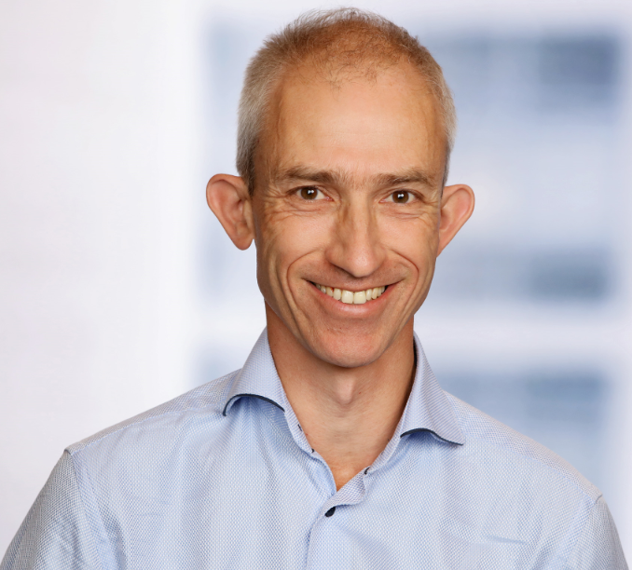
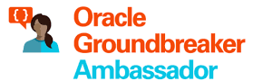




Lucas Jellema CTO for AMIS | Conclusion Cloud Solution Architect
lucas.jellema@amis.nl | technology.amis.nl | @lucasjellema | lucas-jellema

Slide 3

Programming ➔ Software Engineering
“Writing code that works”
Programming

Slide 4

Programming ➔ Software Engineering
“all of the tools and processes an organization uses to build and maintain that code over time. What practices can a software organization introduce that will best keep its code valuable over the long term? How can engineers make a codebase more sustainable and the software engineering discipline itself more rigorous”
“Writing code that works”
time
Programming
Software Engineering

Slide 5
Your organization’s codebase is sustainable when you are able to change all of the things that you ought to change, safely, and can do so for the life of your codebase.

Slide 6
Time and Change
Functional Requirements because of new insights, business evolution and innovation
Non-Functional requirements because of growth, costs and regulations
Technological advances (& deprecations) and shifts in community and among vendors
Team members joining and leaving
Changes in organization structure, scale, processes
Memories fading

Slide 7

Passage of Time
business critical
competitive advantage
cutting edge
sparkling new
buzzing with energy
breakthrough innovation
high visibility

Slide 8
Passage of Time
business critical
old
legacy
not modern
custom software
Notes:
not extraordinary!
Old, not modern
5TB in RDBMS, 50 applications, 2000 components/programs, 1.5M “lines of custom code”
fragile/issues
end of scale
stagnant / no innovation or evolution (SoR)
Expensive TCO
Critical to business
No test sets, no specifications, no documentation
Low on expertise: with tech stack, functionality, development and ops
pile of tech debt – business always in a hurry, IT caved in; no budget to technical upgrades/maintenance
Vulnerable

Slide 9
Passage of Time
high technical debt
no tests, no specs, no docs
end of scale
fragile
no evolution
low on expertise
expensive TCO
Notes:
not extraordinary!
Old, not modern
5TB in RDBMS, 50 applications, 2000 components/programs, 1.5M “lines of custom code”
fragile/issues
end of scale
stagnant / no innovation or evolution (SoR)
Expensive TCO
Critical to business
No test sets, no specifications, no documentation
Low on expertise: with tech stack, functionality, development and ops
pile of tech debt – business always in a hurry, IT caved in; no budget to technical upgrades/maintenance
Vulnerable

Slide 10

Notes:
technical erosion
slowly eating away

Slide 11

Not all code is created equal
Demo in presentation or workshop
Explorative / R&D / Doodles
Assignment in study or training
Snippet in a blog-article
Proof of Concept
Prototype
MVP
Alert Condition evaluation
Product with a very short time to live (several weeks, not any longer)
Contribution to open source project
(internal) Reusable Library
Operating system for guided nuclear missile/ SpaceX vehicle
Unit-test for code component
Healthcheck/smoketest
Not Production Ready: not (necessarily) Professional Quality Software
(potentially) Production : Professional Quality Software

Slide 12
What is software?

Slide 13
What is software? Any instruction executed by a machine!

Slide 14
Types of code - with distinctions in test, management, release , monitoring
Busines Run Time
Application
Tools/Macros/Scripts for Design & Development & Test & Process
Platform
Deploy/Provision Time
Infrastructure
Notes:
Mergeable
Granularity/unit of… delivery/build/
Code analysis
Structured (declarative)

Slide 15

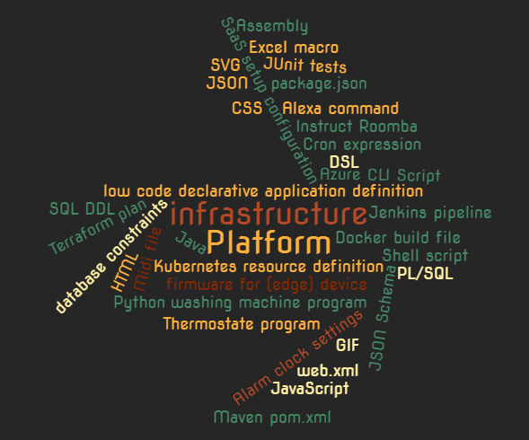
Everything is Code

Slide 16

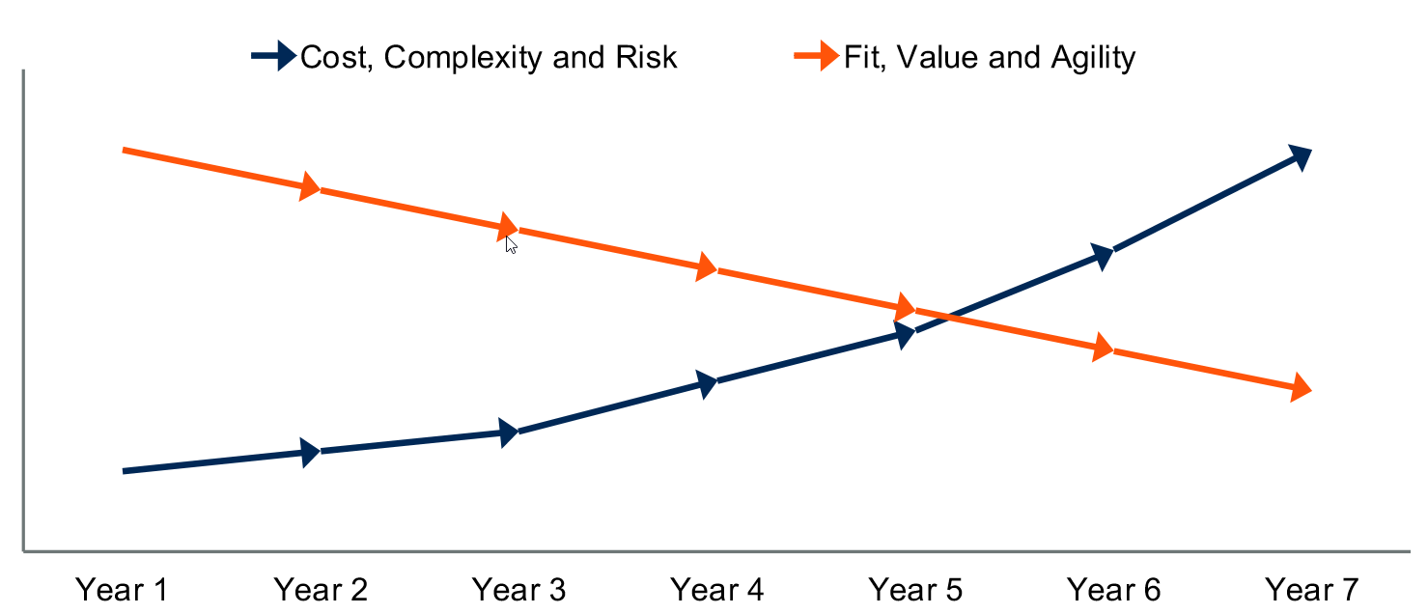


Lifetime of a software application

Slide 17
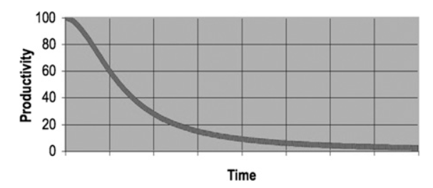
Productivity as function of time
The Legacy Curve

Slide 18
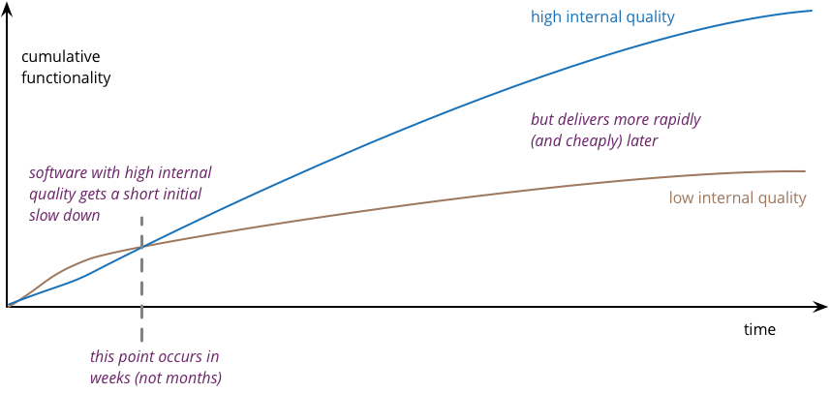
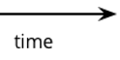
Productivity as function of time and code quality
source: https://martinfowler.com/articles/is-quality-worth-cost.html

Slide 19
Productivity as function of time and code quality
source: https://martinfowler.com/articles/is-quality-worth-cost.html

Slide 20
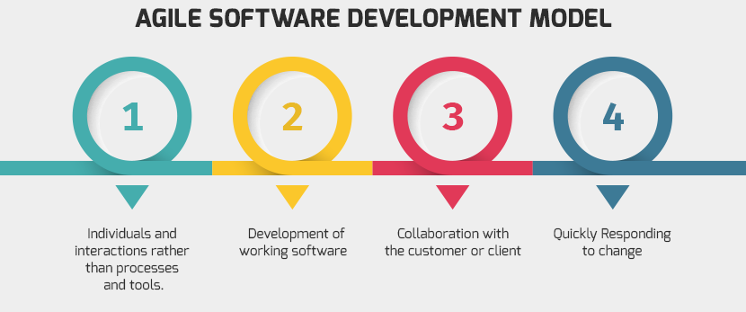
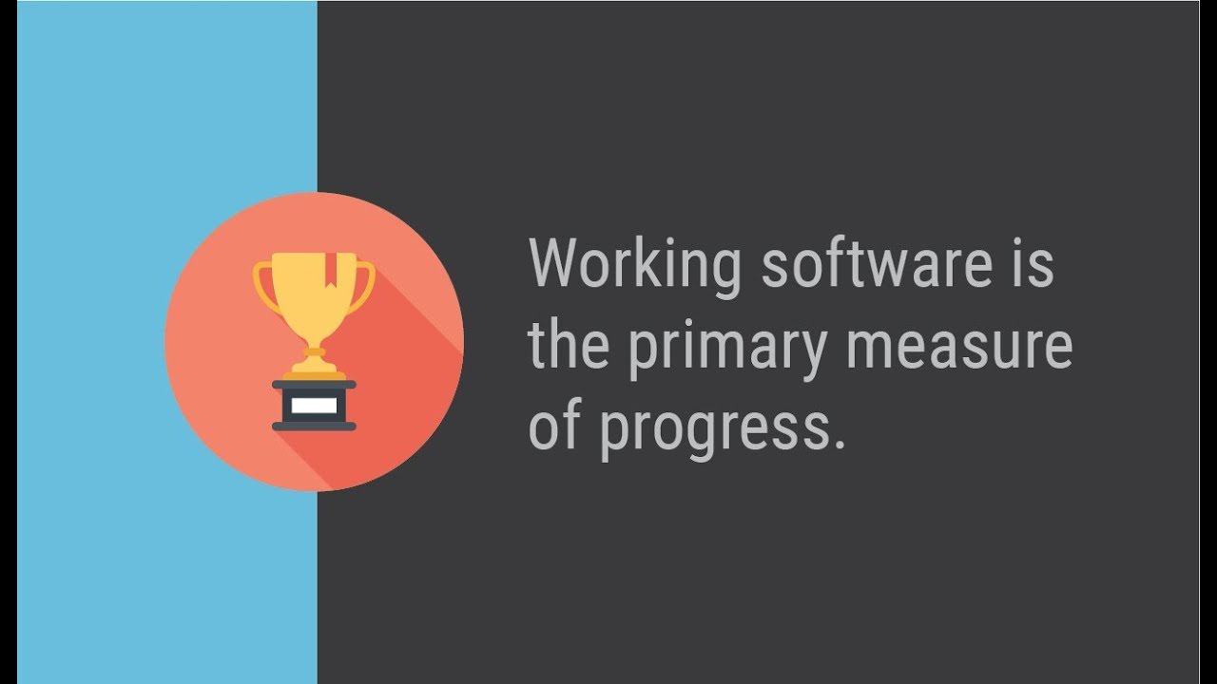

Slide 21
Working Software
What work does it do?
How can you tell?
Working Software

Slide 22
Small step for mankind…
From Working Software
To Professional software

Slide 23
Professional Software is ABLE Software
Verifi
Test
Oper
Read
Evolv
Maintain
Observ
Scal
Recover
Prov
Afford
Deploy
Audit
Impenetra
ABLE

Slide 24
Working => Professional Software
Professional Software
Working Software

Slide 25




Stages in Software Lifecyle
Put to Rest
Professional & ABLE: Live Software (under Ops)
oPeRate
Production
DoD
Preparation
Deployable Software = DONE
Pull Request
Peer Review
Production Ready
Built Software
DoaD
Team
Professional Code
Developer
Working Software
DoR
Team
PRoof
Functional Specification
Behavior & Unit test

Slide 26
Working
according to functional specifications and technical interfaces
proven
Working Software

Slide 27

Behavior Test
The required behavior as experienced from the outside
specify
document
verify
Working Software
DoR
Functional Specification
Behavior test
Team

Slide 28

Unit Test
Verify behavior of
APIs & Interfaces
Reusable elements
Algorithms
Aspects
Functionality
Non Functionality
Happy & Non-Happy
not: dependencies

Slide 29

Test is many things
Functional contract (specification and documentation)
Quick (REPL) feedback cycle for developer
Proof of “working”
Insulator that allows
refactoring and code optimizations
technical upgrades
Regression detector
for things changed
Health indicator & Smoke detector
Reference for (re)using code
and things unchanged but impacted by changes

Slide 30

Who creates the test?
and at what time?
Who (or what?) executes the test
at what moment | trigger?
what is the outcome
Who checks on the tests?
specification coverage
code coverage
[real world] condition coverage
timely execution of test and handling of result

Slide 31

Definition
functional specifications clear, unambiguous and understood
boundary conditions, non happy cases and exceptional situations are covered in specifications
non-functional requirements are clear
business value of feature is defined
TCO budget is specified
Notes:
Test can only be created when story is ready
DoR
functional specifications clear, unambiguous and understood
boundary conditions, non happy cases and exceptional situations are covered in specifications
Non Functional Requirements are clear
Business Value of feature is defined
TCO budget
Reference architecture
Design & implementation guidelines
Technical Debt

Slide 32
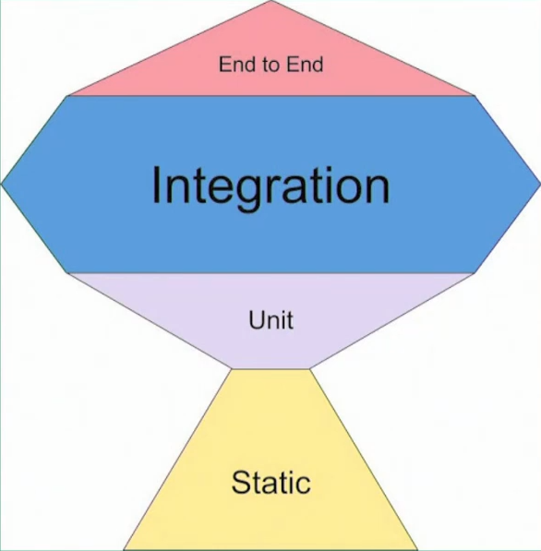
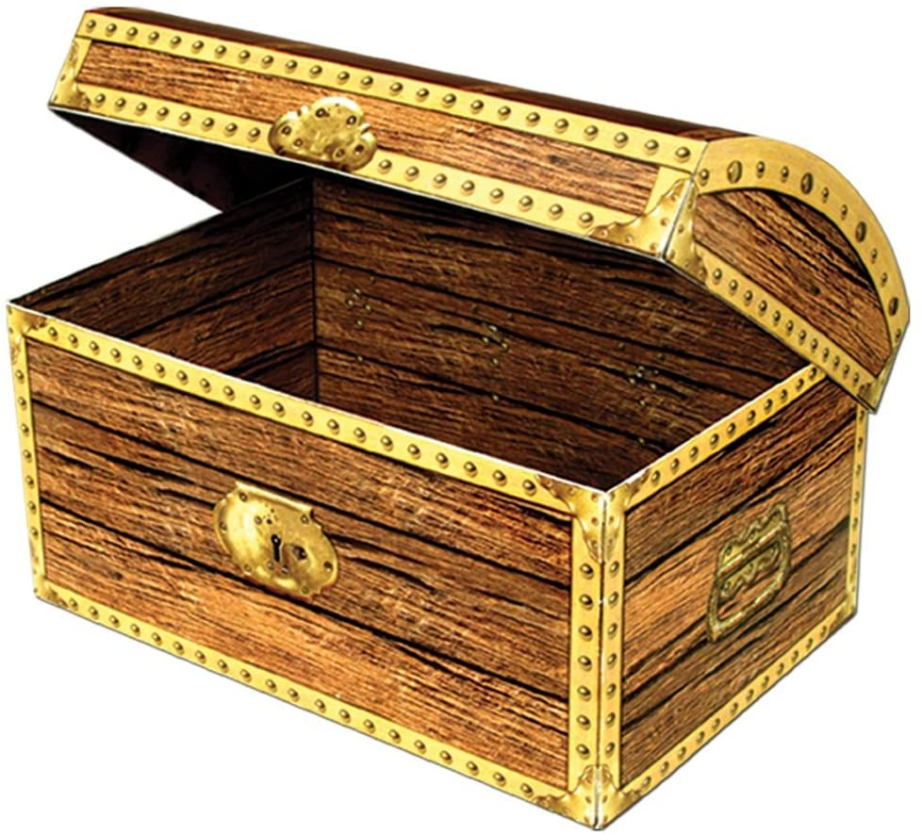
Test Trophy
Live
Test Data

Slide 33


Breach of Contract – at Dutch Court Systems (no obvious technical debt)
users could no longer submit court cases
eCase
Portal
Team UI
Composite Business Service
Team Linking Pin
Entity Service
a check constraint was added
Court Cases DB
Team On Your Case

Slide 34


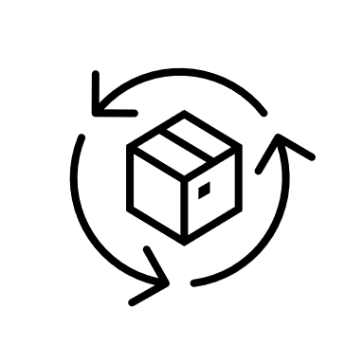
Breach of Contract – at Dutch Court Systems Process Refinement
eCase
Portal
Team UI
Composite Business Service
Team Linking Pin
Every team prepares test set
for other teams to automatically run when they roll out any changes
Entity Service
Court Cases DB
Team On Your Case

Slide 35
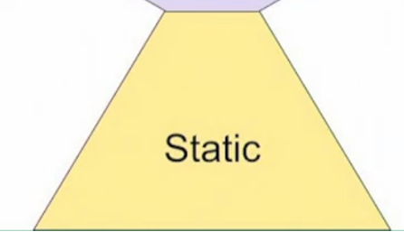


QA: Static Code Analysis
According to coding standards
Consistent
Readable (naming, formatting, length, …)
Maintainable (Code Smells)
Limited complexity
Code Coverage (of tests)
Vulnerabilities (in dependencies)
Automatic improvements

Slide 36
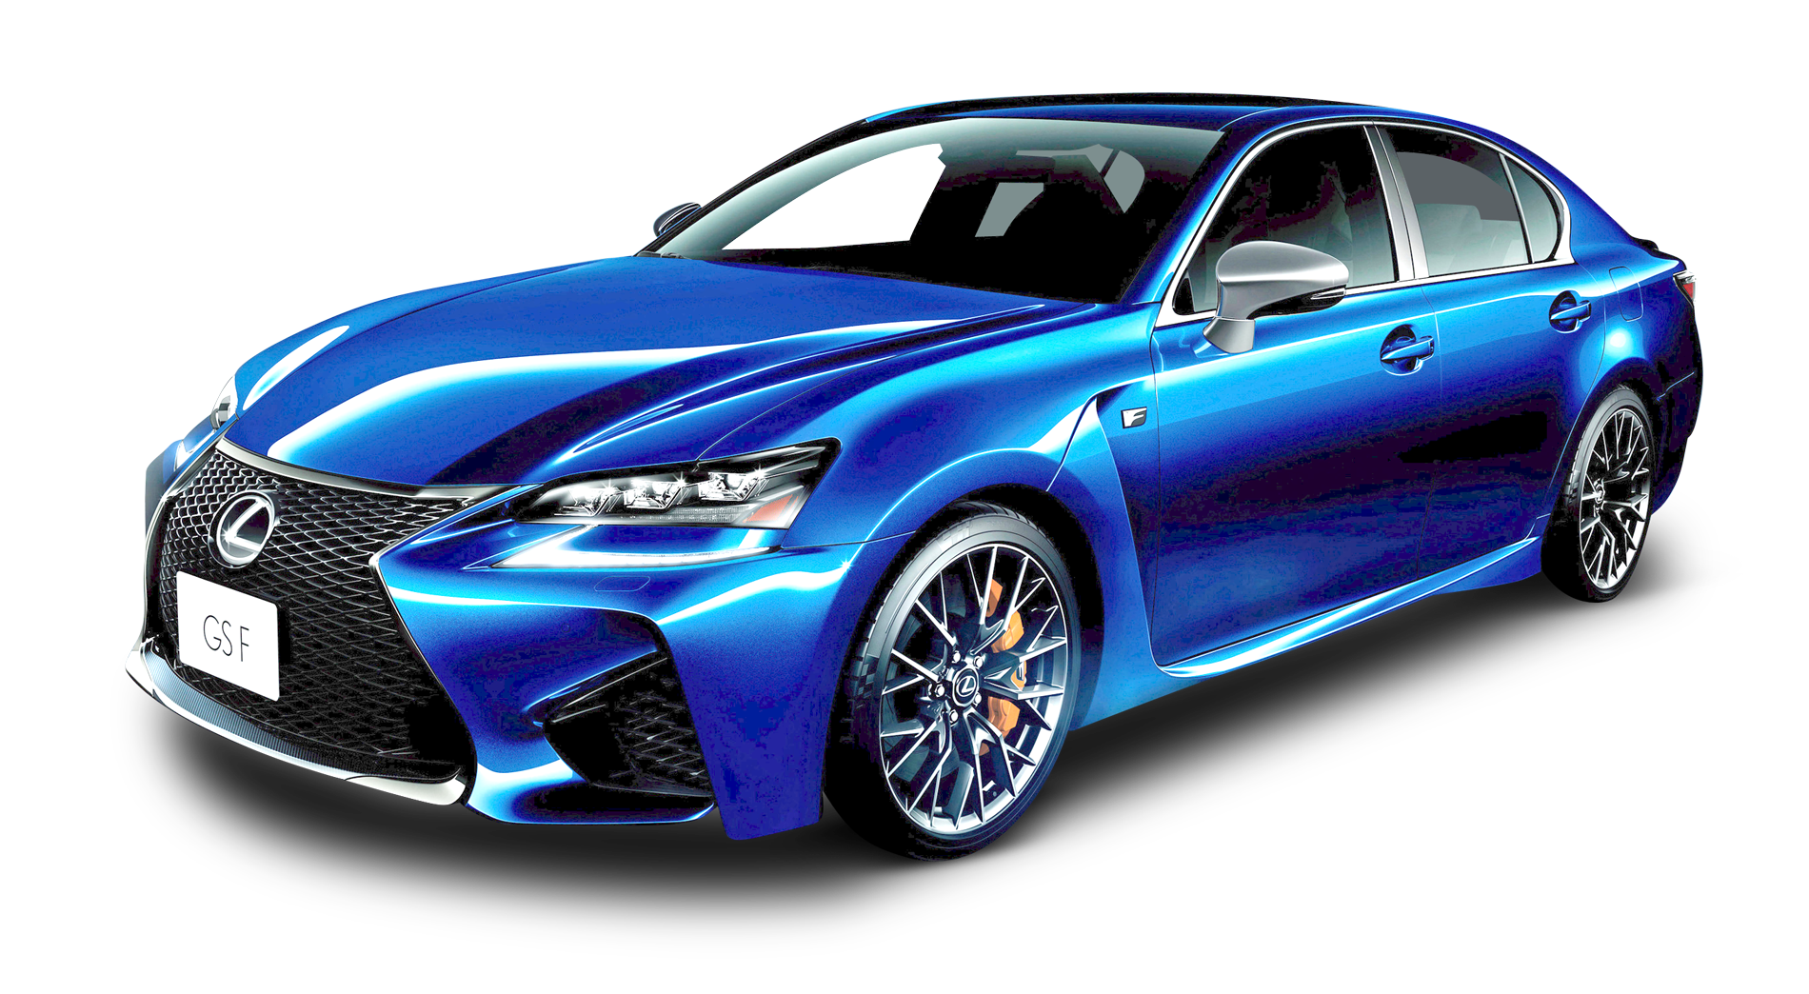

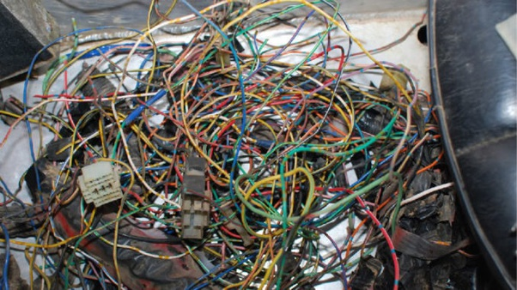
Refactoring

Slide 37
Application Architecture
External Systems
Internal Systems
Frontend (web, chat, public API)
API/
Internal Interface
Business Logic
Internal & External Systems Systems
Persistence
(of state) – pluggable persistence providers

Slide 38
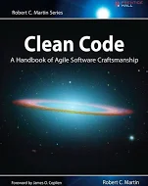
Refactoring towards Clean Professional Code
Compliance with coding standards
Reducing complexity
Increasing readability
Testable & test coverage
Operable
logging
metrics
configuration settings
Life cycle management of technology stack & technical debt
Needed: Local build pipeline and runtime environment to quickly and frequently do code analysis, pull & merge from master, build & automated test
DoaD
Professional Code
Developer
Refactoring
Working Software
Unit tests & QA
(Behavior Tests)

Slide 39
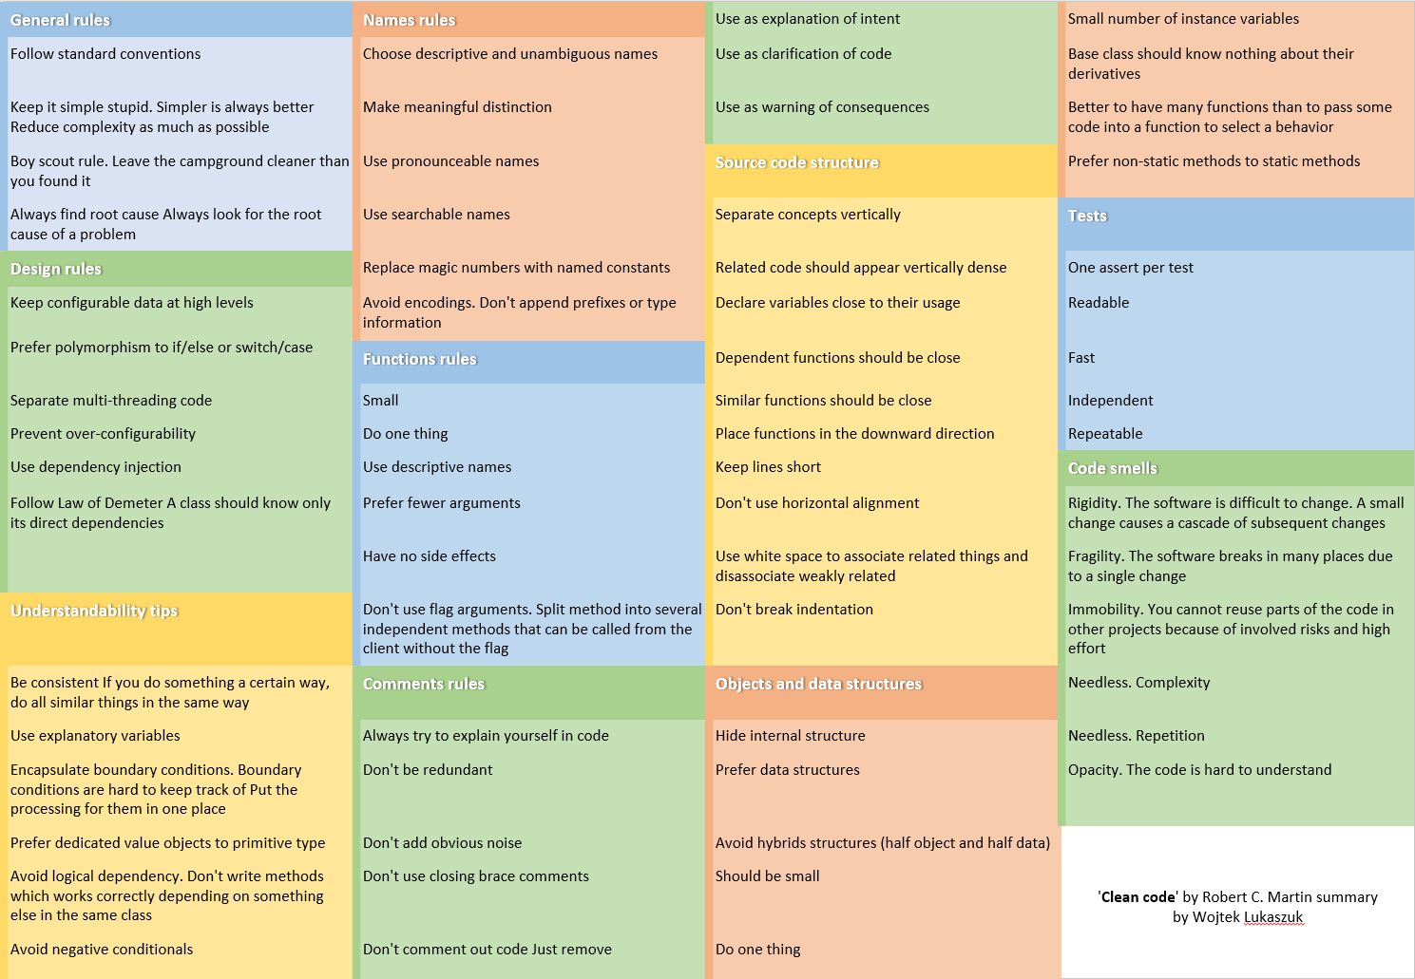
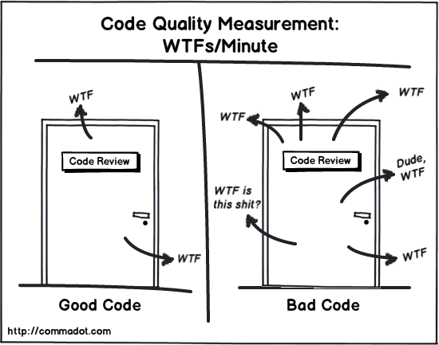
Clean Code Guidelines

Slide 40


The Debt Mountain
Functional Debt
Product Owner
Architect
Tech Debt
Ops Debt
Scrum Master
Team Process Debt
Team
Organization Debt
Community Debt

Slide 41
Technical Debt
Owner: Architect (*
Found during: Dev, Code QA, Review
Tech Debt
Ops Debt
Hard coded styles in web pages
Low (to no) test coverage
Complex, deeply nested, large, hard to understand code units
Meaningless or even confusing variable names
High degree of coupling
Low quality documentation
Magic numbers (hard coded values) in program code
Use of deprecated òr unsupported technologies
Use of exotic features that no one understands but Jim
Manual steps in CI/CD
Frequent substantial redesign of architecture/ platform / tech stack
Libraries with security vulnerabilities
Use of technologies not known or wanted by team
Impact/Risk (Longer Term)
Changes increasingly become harder (lengthy, costly, risky) – low agility
Hard to keep/find & motivate technical staff
Drop in Team Productivity (velocity)
Production incidents
Increased Vulnerability

Slide 42

What to do about debt?
Identify debt during
refinement, review, test, Ops intake, retrospective, audit, on boarding
analysis, development, production usage
Make debt explicit and visible – in a debt register and the risk log
what and where
severity, risk and impact (running cost!)
resolution: how and effort
Discuss debt (risks, running cost of not fixing) & plan actions
in every sprint planning
in every steering committee session
…
Continuously work on reducing debt – in small steps
boy scout principle (improve everything you touch)
explicitly set sprint budget aside
Debt status should be a Team KPI
Focus on a root cause: Team Process Debt
Functional Debt
Risk Log
Tech Debt
Ops Debt
Debt Register
Team Process Debt
Organization Debt
Community Debt
Team Story Backlog

Slide 43
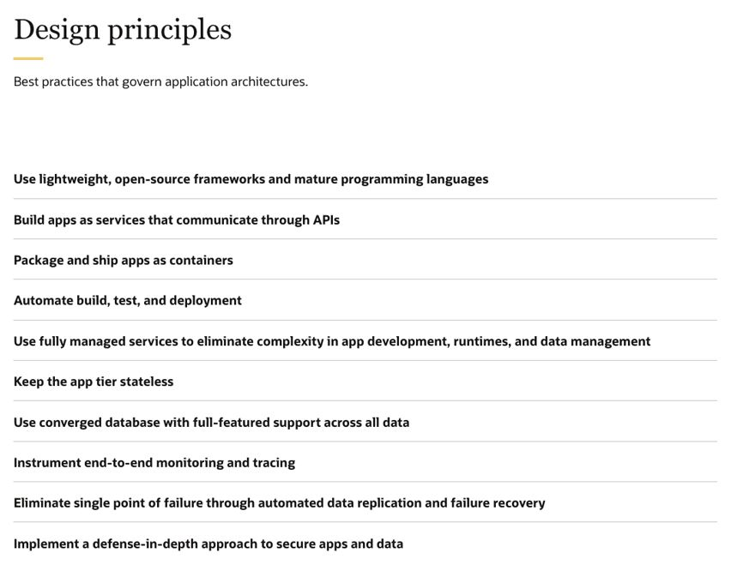
Prevent or at least Manage Tech Debt
Design Principles & Reference Architecture
Reusable Building Blocks
Architecture Design Decisions
identify/define
process for deciding
prototype
record
Application and Feature Portfolio Management & Technical Life Cycle Management
usage and state => risk
effort to upgrade or replace
Team Process:
Definition of Ready – include solution design (how & non functionals)
Definition of Done
Peer Review
source: Oracle Cloud Reference Architecture
Notes:
lijst van design decisions
die gaan komen, nu spelen en recent genomen zijn
per beslissing
wat (waar in het grotere solution design van de Data Market)
waarom & wanneer
eventueel samenhang met andere Design Decisions
overwegingen/criteria - op basis waarvan gaan we de keuze maken/alternatieven beoordelen
welke opties/alternatieven onderkennen we
keuze plus motivatie (en wie waren betrokken)
moet er een PoC vooraf of evaluatie achteraf worden gedaan?

Slide 44
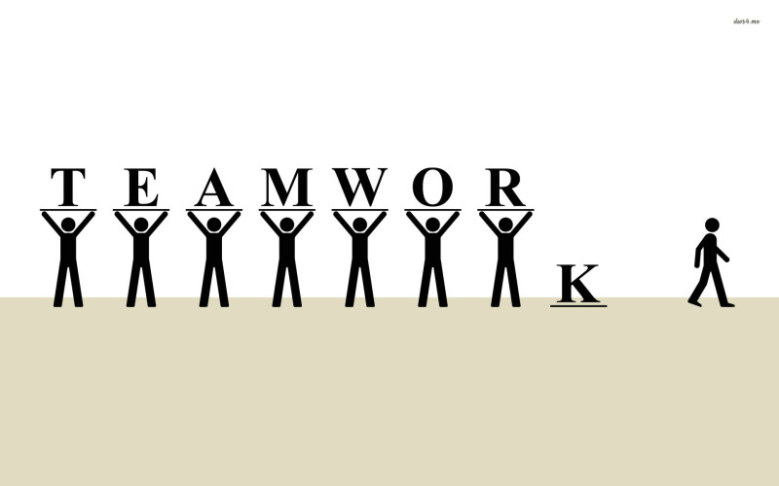
Team
That story is in Janet’s area
Sorry, Tom is on leave so we cannot work on X right now
Our tester is working on running all automated tests
Ellen is the only one on our team who can work on the Python components
Thomas knows how the CI/CD pipelines work
I am not sure what business feature Sophie is working on this sprint
Bob built it, he knows how to demo it
This [one year] old code is hard to maintain because the person who built it has left the team

Slide 45
Metamorphosis – the miracle of the PR
Notes:
Caterpillar to Butterfly
From personal code to team treasure
From branch to trunk
From mine to our

Slide 46
Metamorphosis – the miracle of the PR
PR
Pull Request
Peer Review
Production Ready
Notes:
Caterpillar to Butterfly
From personal code to team treasure
From branch to trunk
From mine to our

Slide 47
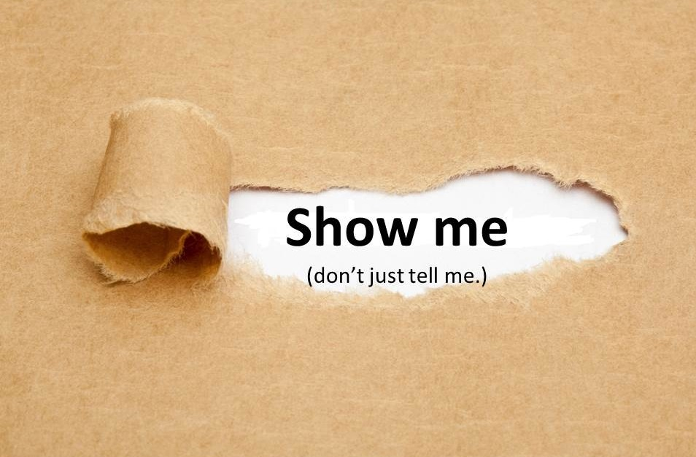
Pull Request == Please Review ?!
DoaD
Team
Professional Code
Developer
Appreciate my work and learn from it
Help me improve it
and become a better developer
Take co-ownership of this code

Slide 48

Peer Review completes the Pull Request
Peer Review completes (only) when
Code is ABLE
and beautiful
the code is merged from the branch to the trunk
and the tram may roll in
because the peer considers the code their own
Give priority to Peer Review!
respond ASAP to Pull Request
a proper Peer Review takes real commitment and substantial time (proportional to the complexity of the story)
Team
Professional Code
Developer

Slide 49
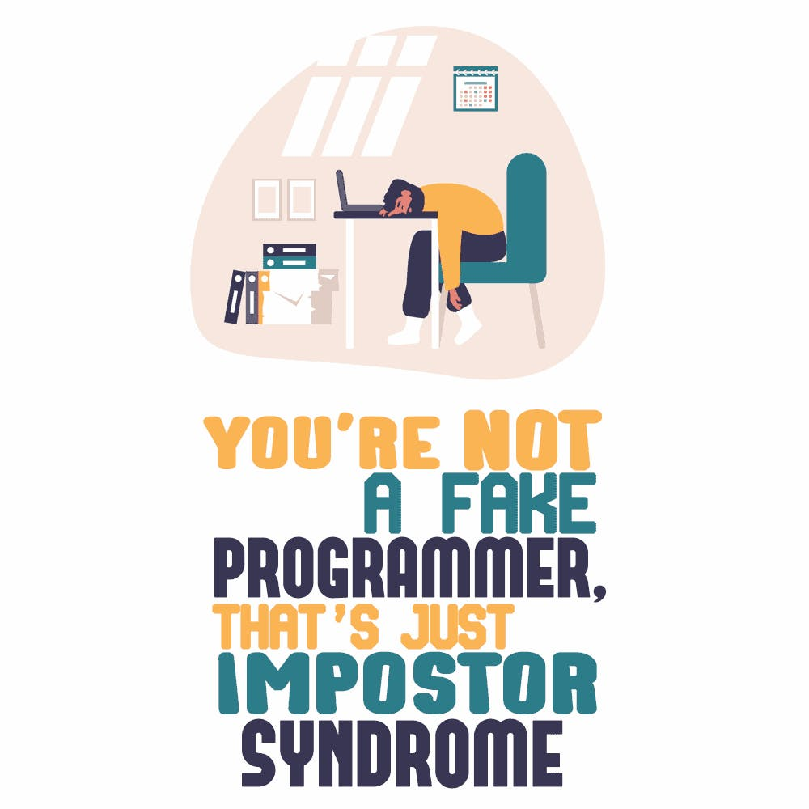
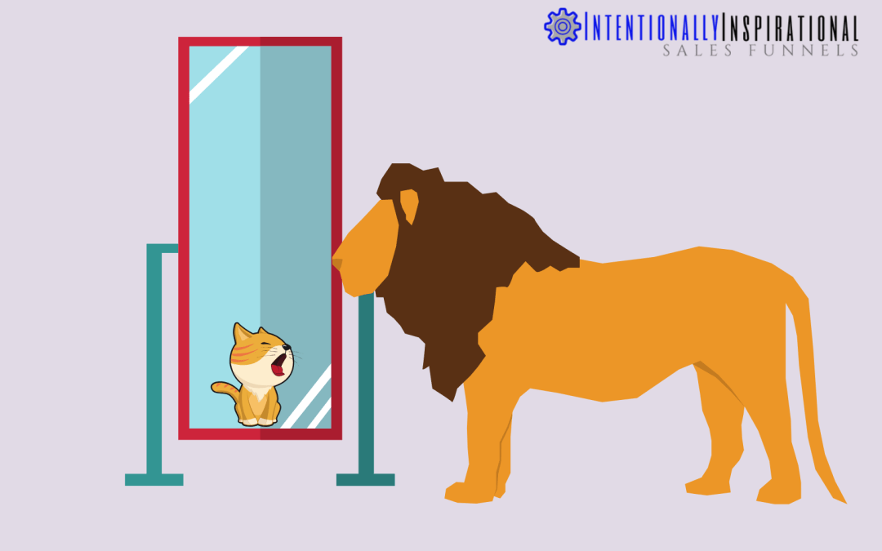
Impostor Syndrome
a psychological pattern in which an individual doubts their skills, talents, or accomplishments and has a persistent internalized fear of being exposed as a "fraud“
quite common among software developers
psychological safety in the team is crucial to help members be free

Slide 50
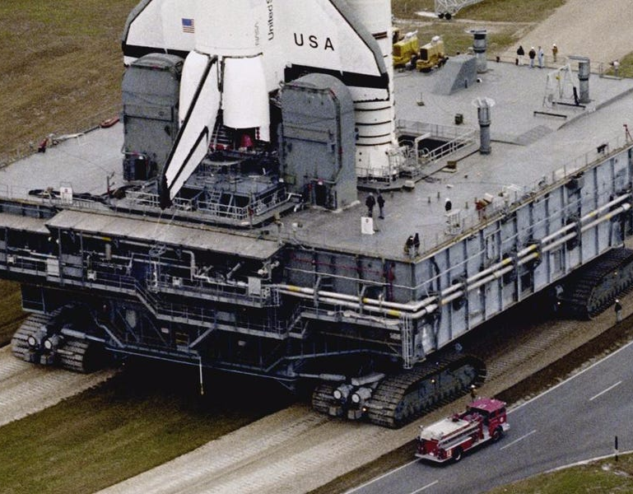
Definition of Almost Done
Code on trunk
ABLE
Compiles | Can be Built
Satisfies
QA
Test (behavior & code)
Non-functional characteristics (absolute & trend)
Vulnerability
Guidelines and Standards
Automated CI/CD pipeline
(covered by) Smoketest
Technical Debt management
Built Software
Professional Code

Slide 51
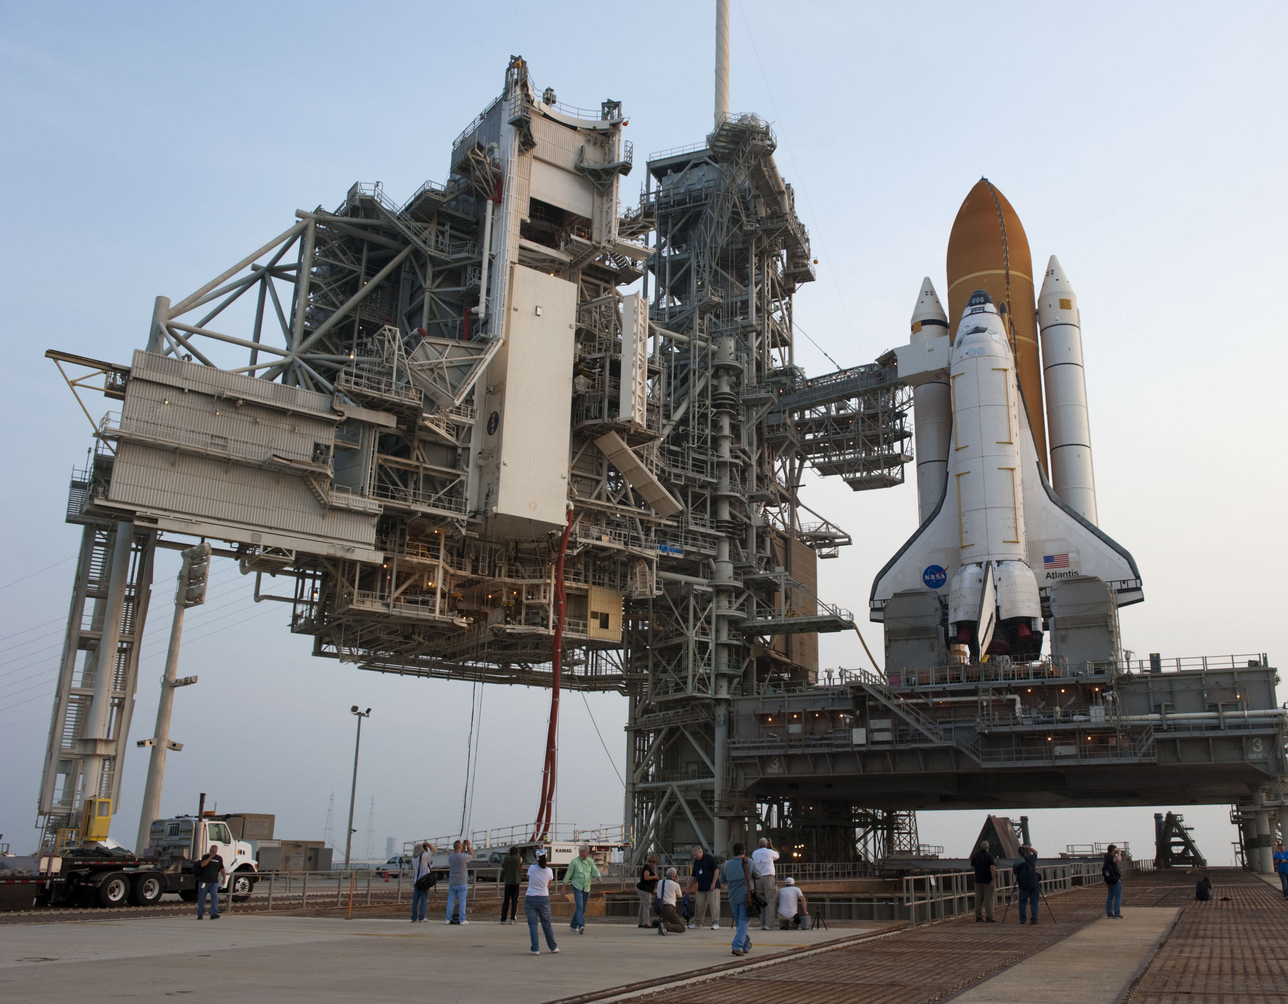
Deployable == Done (as far as team is concerned)
Deployable – but not yet deployed
deploy decision is up to business
CI/Continuous Delivery = fully process up to deployability
Continuous Deployment: automatic roll out when DONE
Deployable Software = DONE
DoD
Built Software
Professional Code

Slide 52

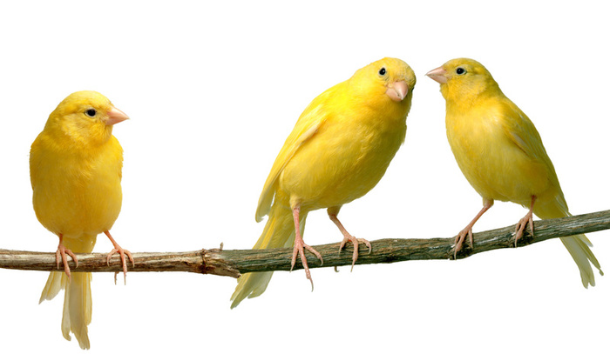
Deploy
Business decision
Automated – no touch
Fusion of code & environment configuration
Smoketest post deployment (and periodically to check on health)
Operations activated
Professional & ABLE: Live Software (under Ops)
Configuration
Production
Preparation
Deployable Software = DONE
Built Software

Slide 53
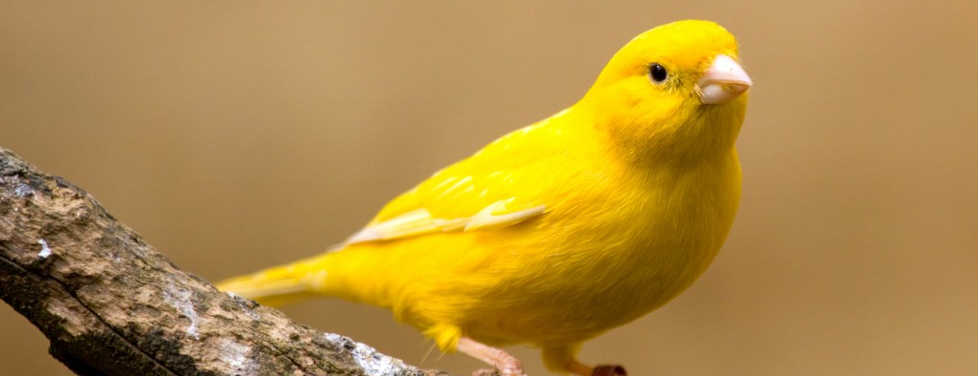
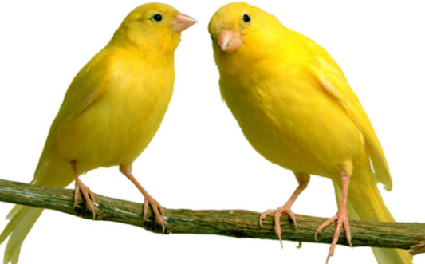
Canary
Notes:
ultimate test is production
controlled production roll out is one way to perform (final) test

Slide 54

Observe the canary
Notes:
log analysis (splunk, elastic, azure or OCI log analytics)
metrics analysis
real time and trends

Slide 55
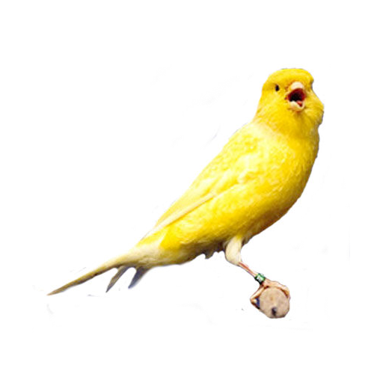
Fix Forward
Fast Fix is not a special procedure nor a special environment
Tiered roll out
Spot issue [very quickly]
Assign priority
Define test (to reproduce and guard against regression)
Create fix on branch
working code
professional code
PR and Merge to trunk => DONE
<business decision>
Roll Out

Slide 56
1202
Notes:
https://www.slideserve.com/ayala/se-3910-real-time-systems

Slide 57
1202

Slide 58
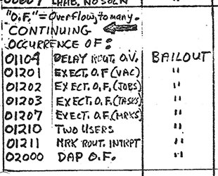




1202

Slide 59
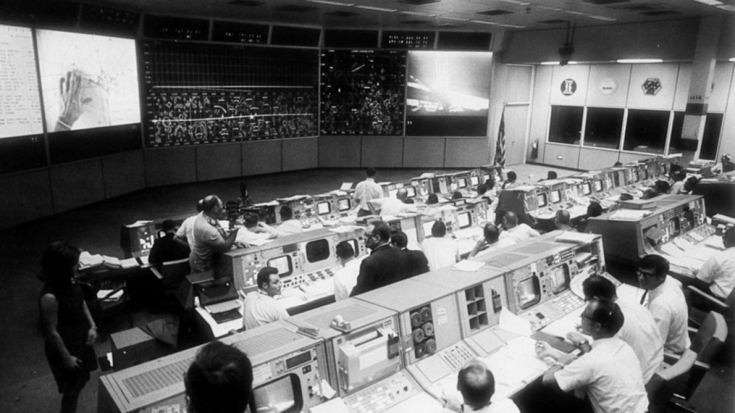
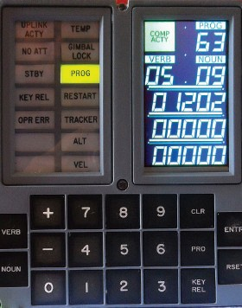


Slide 60
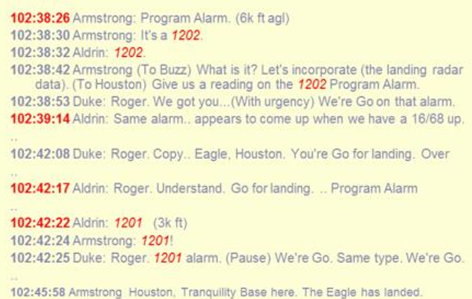

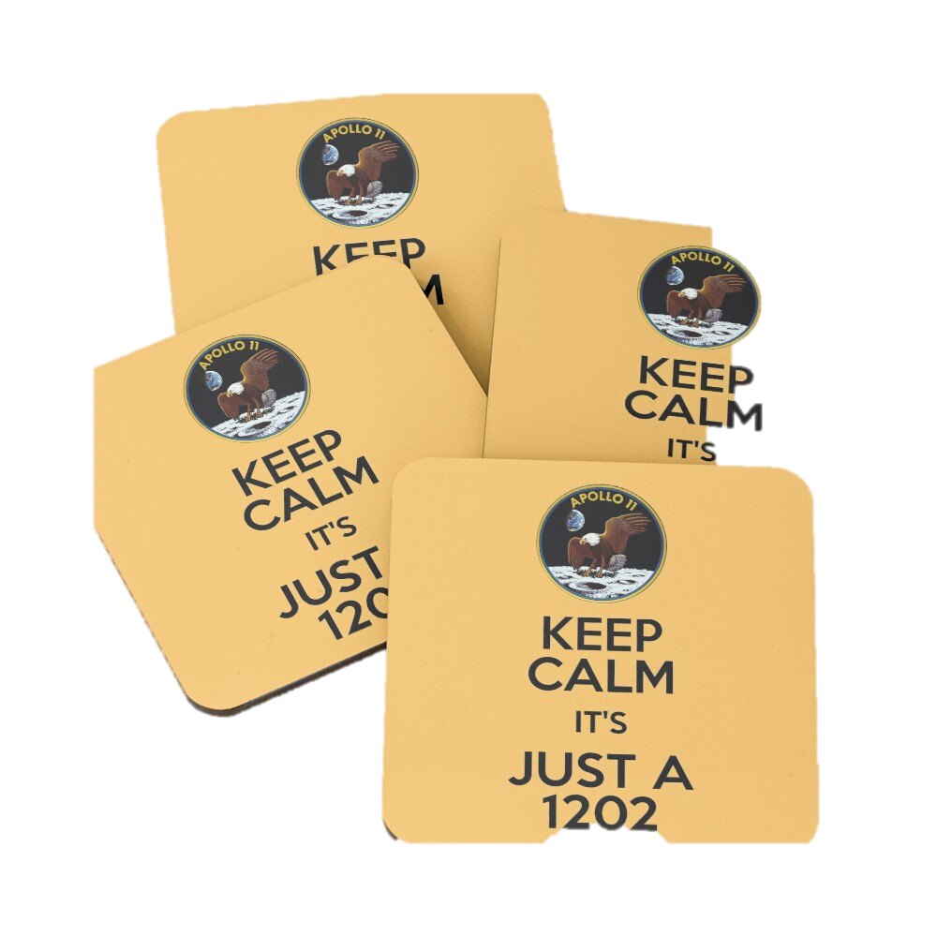
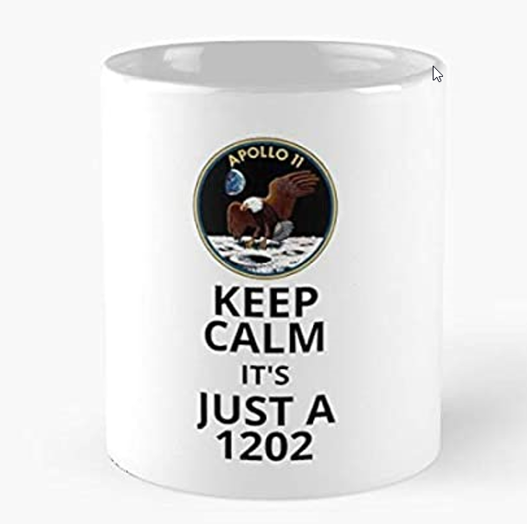



Slide 61
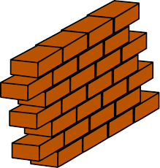


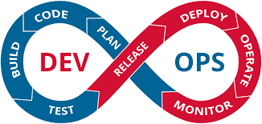
Development
scale, performance, security, stability, recoverability, monitoring
Production

Slide 62
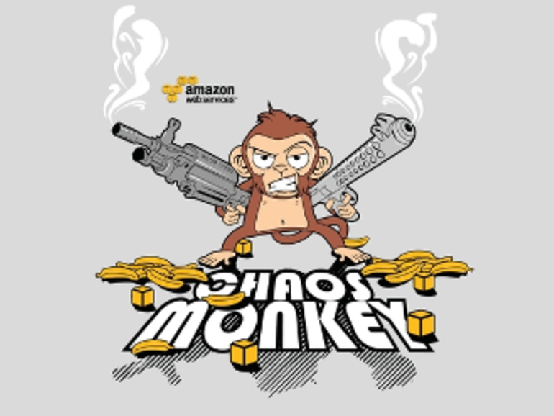
Observing the Monkey
“fire drills” – in live systems
Testing Resilience of
systems & automated procedures
processes
people
By deliberately introducing errors in runtime environments
even in production ?!
To test & prove & enhance measures
Azure availability zone is down
Ransomware alert
Storage inaccessible
Data Corruption (human error)
expired certificate
team tech lead falls ill
Edge connectivity lost
Critical vulnerability in library
failing DNS server
Product Owner cannot be reached
P1 bug in recent production release
Power outage
DDOS attack detected
Wiki is down
Notes:
expired certificate
Product Owner cannot be reached
Wiki is down
Storage inaccessible
Critical vulnerability in library
DDOS attack detected
Ransomware alert
Data Corruption (human error)
failing DNS server
Azure availability zone is down
team tech lead falls ill
P1 bug in recent production release
Edge connectivity lost
Power outage

Slide 63
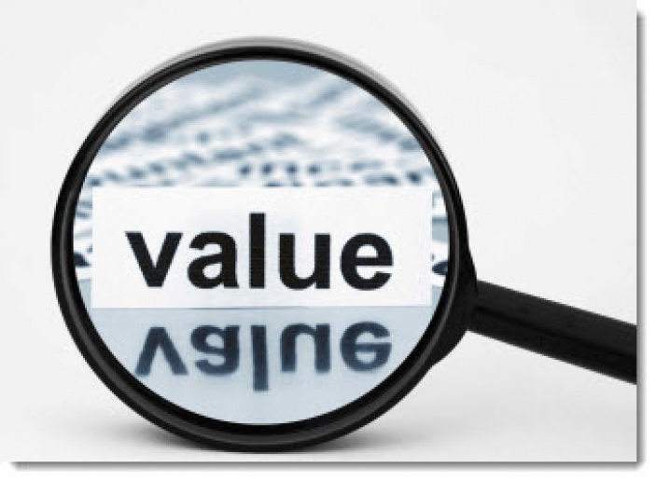
Professional Software – Generating Value for the Business

Slide 64


Slide 65
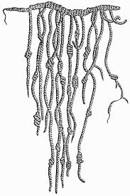

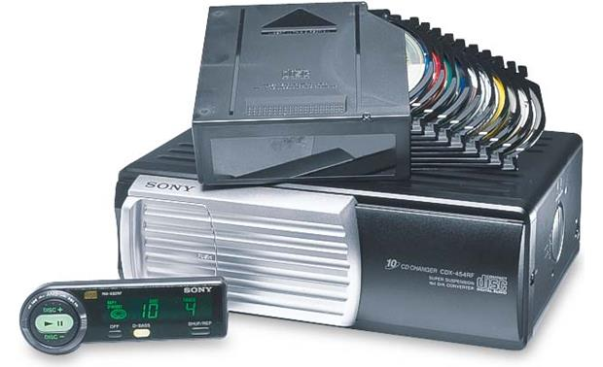
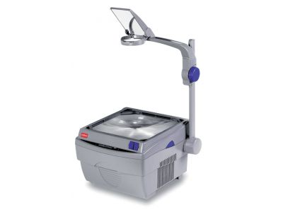


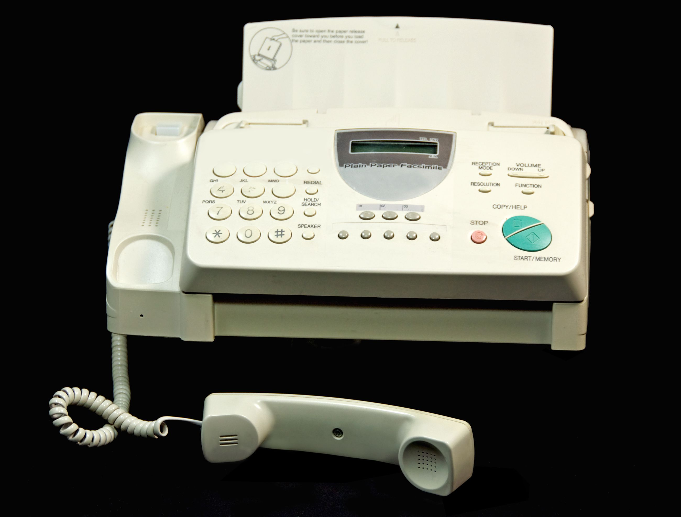
Software Wears Down

Slide 66
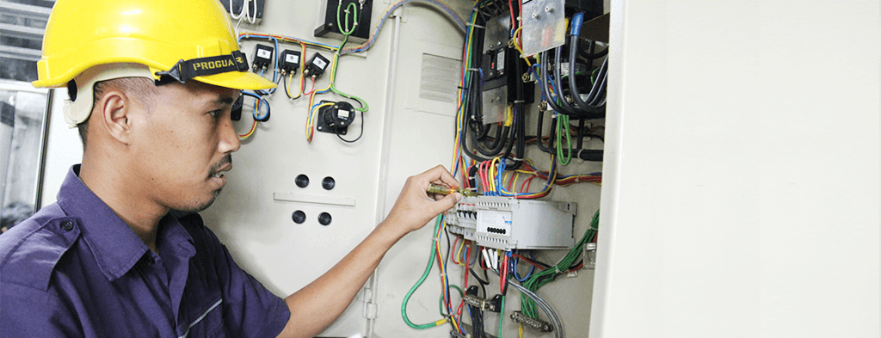
Life Cycle Management – Functional and Technical Maintenance
Periodic Review
Ensure the up-date-ness of the application and all its dependencies
functional: which features are not used (and can be dropped), which are suboptimal for users and require workarounds
technical: which tech stack components are deprecated or even forbidden, for which technology components do we no longer have the skills?
cost: which elements are way too expensive for the value rendered?
Notes:
Elk event leidt tot technical debt en/of actie/user story
DevOps team houdt status bij van applicatie-componenten en platform-onderdelen en tools (functioneel, non-functioneel en technisch

Slide 67
Life Cycle Management – Technical Maintenance
Triggers for review (and change) – proactively monitored by the DevOps Team
A CEV vulnerability (CVE database https://www.cvedetails.com/) Release (or patch) of 3rd party library/framework New or deprecated (feature in) PaaS Service Custom pricing in used or unused service New specification from the business New non-functional requirement Incident/bug – functional or non-functional Technical debt assessment New version of platform component:
e.g. Docker, Kubernetes, Java, Node
New/custom architecture choice/guideline New/custom coding standard New tool, new version of tool Law & Regulation, Ethical Insights Mere Progression of Time
Periodic Review
Notes:
Elk event leidt tot technical debt en/of actie/user story
DevOps team houdt status bij van applicatie-componenten en platform-onderdelen en tools (functioneel, non-functioneel en technisch

Slide 68

Automation
Facilitate team members
Reduce risk through frequent and small steps
Increase productivity of (scarce) resources
Reduce errors, increase quality
Increase speed of process step execution
Increase reaction speed (quicker value)
Make things actually happen
Scale up
Reduce costs
source: https://enterprisersproject.com/article/2021/1/automation-4-trends-2021
vulnerability scan
deployment
end to end testing
software build
technical upgrades
unit testing
code analysis (QA)
health check
provisioning of platform and infrastructure
regression testing

Slide 69
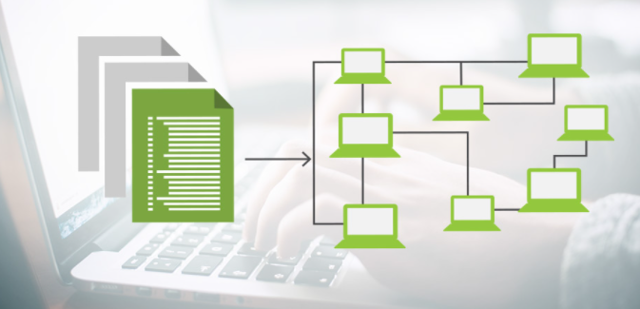
Platform and Infra = Code
Software Engineering practices apply to definitions of Platform and Infrastructure resources
Agile team development process
Source Code Control and Versioning
Testing
Code QA & Peer Review
Automation
Platform & Infra engineer are software developers too

Slide 70

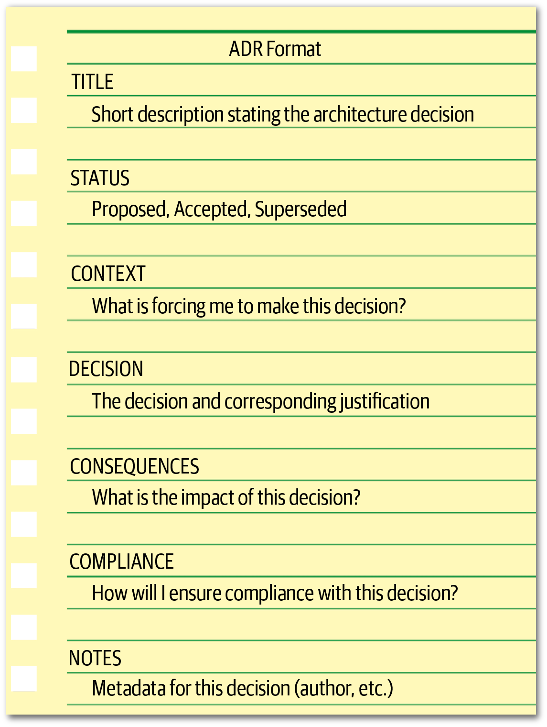
Take, Act On and Manage Design Decisions
Any decision that has impact on technology stack, team way of working, application wide requirements, toolset
Made, shared and recorded in a structured and explicit way
Record: What has been| is being | will be decided?
label & title
what, why & when
current status (could be superseded)
context: place in bigger picture, relation with other decisions
criteria – based on what will we come to a decision
options to choose from
decision – what was decided
why? why not the alternatives?
who & when
consequences/impact/actions
if and when should we evaluate?
source: Fundamentals of Software Architecture
,Mark Richards, Neal Ford

Slide 71
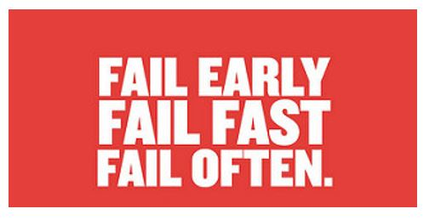
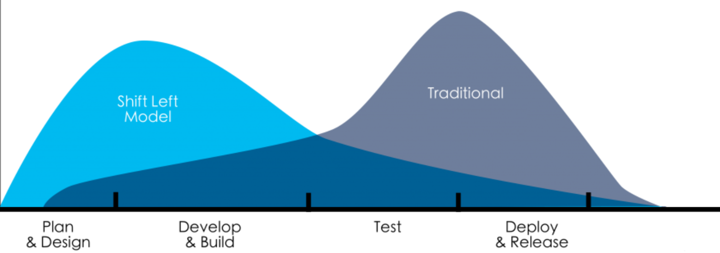
Shift Left
Start attending to important aspects of the code base as early as possible (and strive for design and prevention i/o detection & fix)
security
testing
pair programming or early peer review
trunk based dev
team ownership
build & deploy
operations
automation
TCO
Source: van der Cruijsen 2017

Slide 72
Thank you for your attention I hope this was useful
lucas.jellema@amis.nl | technology.amis.nl | @lucasjellema | lucas-jellema
Notes:
Software Engineering at Google
By Titus Winters, Tom Manshreck, Hyrum Wright

